Slide 1
Fuzzy Logic

Slide 2
Fuzzy Logic
Humans have the incredible ability to communicate skills simply and accurately by using vague linguistic rules.
For example:
A TV chef instruct you how to make perfect cheese on toast like this:
  Cut two slices of bread medium thick.
  Turn the heat on the griddle on high.
  Grill the slices on one side until golden brown.
  Turn the slices over and add a generous helping of cheese.
  Replace and grill until the top of the cheese is slightly brown.
  Remove, sprinkle on a small amount of black pepper, and eat.

Slide 3
Fuzzy Logic
Fuzzy logic, invented by Lotfi Zadeh in the mid-sixties (1965).
enables a computer to reason about linguistic terms and rules in a way similar to humans.
Concepts like "far" or "slightly" are not represented by discrete intervals, but by Fuzzy Sets.
  Enabling values to be assigned to sets to a matter of a degree.
  This process called Fuzzification.
Using fuzzified values computers are able to interpret linguistic rules and produce an output that may remain fuzzy or — especially in video games — can be defuzzified to provide a crisp value.
This is known as Fuzzy rule-based inference, and is one of the most popular uses of fuzzy logic.

Slide 4
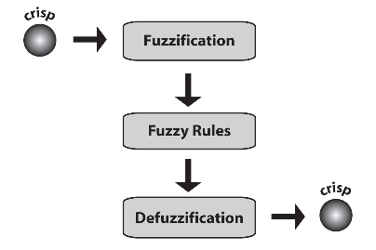
Fuzzy rule-based inference

Slide 5
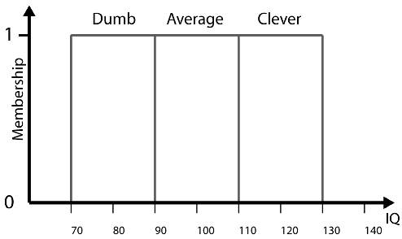
Crisp Sets
Crisp sets = mathematical concepts taught in school
Example: IQ sets = Dumb, Average, and Clever
Dumb = {70, 71, 72, … 89}
Average = {90, 91, 92, … 109}
Clever = {110, 111, 112, … 129}

Slide 6
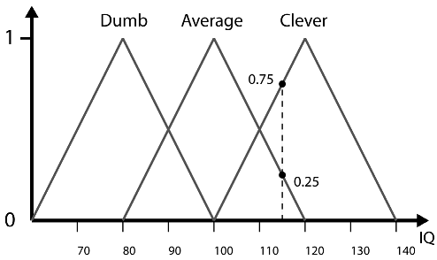
Fuzzy Sets
Degree of
Membership
(DOM)
Suppose Paimin, who has an IQ of 115.
  His IQ is a member of two sets: Clever is 0.75 ; Average is 0.25.
This is consistent with how a human would reason about Paimin’s intelligence.
  A human will consider him to be mostly clever.

Slide 7
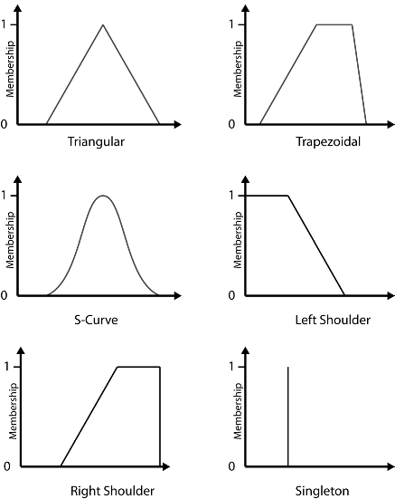
Membership Functions

Slide 8
Forming Fuzzy Set
We need to define its membership function.
One approach is to poll a group of people for their understanding of the term that we are attempting to represent by the fuzzy set.
For example: Consider the concept of Indonesian man height.
  We could make pollings for terms short, medium and tall.
When we define multiple fuzzy sets on the same universe of discourse, they call as Fuzzy Subsets.

Slide 9
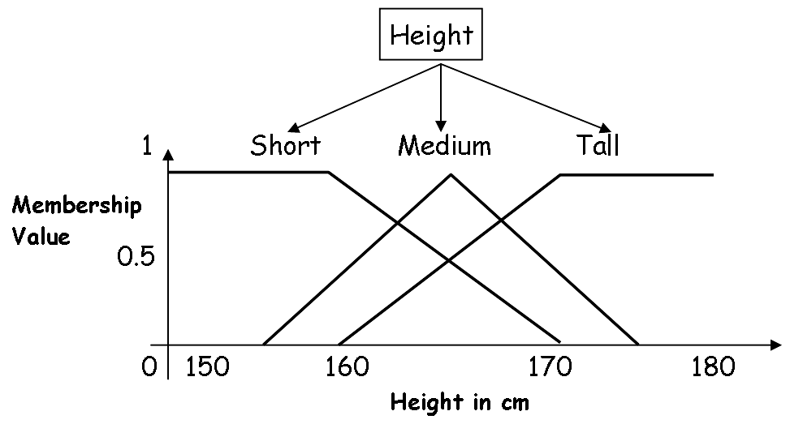
Forming Fuzzy Set

Slide 10
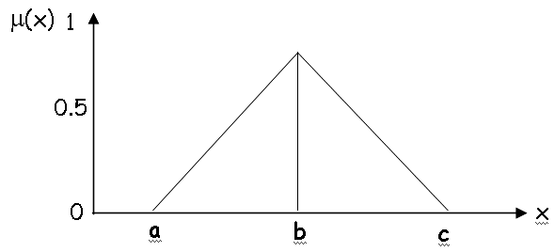
Create formulas from the Fuzzy Sets
Triangular Functions:
μ(x) = 0 for x < a
μ(x) = (x - a)/(b - a) for a ≤ x ≤ b
μ(x) = (c - x)/(c - b) for b ≤ x ≤ c
μ(x) = 0 for x > c

Slide 11
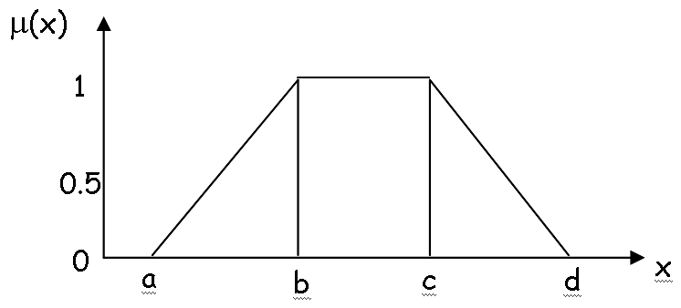
Create formulas from the Fuzzy Sets
Trapezoidal Functions:
μ(x) = 0 for x < a
μ(x) = (x - a)/(b - a) for a ≤ x ≤ b
μ(x) = 1 for b ≤ x ≤ c
μ(x) = (d - x)/(d - c) for c ≤ x ≤ d
μ(x) = 0 for x > d

Slide 12
Fuzzy Linguistic Variables
the composition of one or more fuzzy sets to represent a concept or domain qualitatively.
Example: the sets Dumb, Average, and Clever are members of the fuzzy linguistic variable IQ.
This can be written in set notation as:
IQ = {Dumb, Average, Clever}

Slide 13
Fuzzy Rules
Coventional Rule:
IF Wizard.Health() <= 0 THEN Wizard.isDead()
Fuzzy Rules:
IF Target = FarRight THEN Turn = QuicklyToRight
IF Enemy = BadlyInjured THEN Behavior = Aggressive
IF Target = FarAway AND Allegiance = Enemy
THEN Shields = LowPower
IF Ball = CloseToHole AND Level = Green
THEN HitBall = Gently AND HitBall = DirectlyAtHole

Slide 14
Fuzzy Inference
1. For each rule,
  1a. For each antecedent, calculate the degree of membership of the input data.
  1b. Calculate the rule’s inferred conclusion based upon the values determined in 1a.
2. Combine all the inferred conclusions into a single conclusion (a fuzzy set).
3. For crisp values, the conclusion from 2 must be defuzzified.

Slide 15
Fuzzy Logic in Game (Example)
Designing FLVs for Weapon Selection
  Antecedents: Distance to Target, Ammo Status
  Consequent:Desirability
We focus on designing the FLVs and rule set for the rocket launcher.

Slide 16
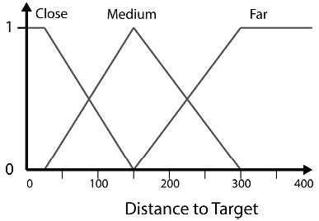
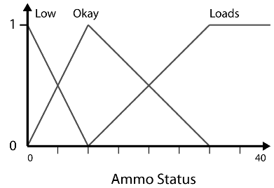
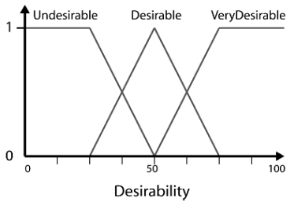
Rocket Launcher selection FLVs

Slide 17
Rule Set for Rocket Launcher selection
Rule 1. IF Target_Far AND Ammo_Loads THEN Desirable
Rule 2. IF Target_Far AND Ammo_Okay THEN Undesirable
Rule 3. IF Target_Far AND Ammo_Low THEN Undesirable
Rule 4. IF Target_Medium AND Ammo_Loads THEN VeryDesirable
Rule 5. IF Target_Medium AND Ammo_Okay THEN VeryDesirable
Rule 6. IF Target_Medium AND Ammo_Low THEN Desirable
Rule 7. IF Target_Close AND Ammo_Loads THEN Undesirable
Rule 8. IF Target_Close AND Ammo_Okay THEN Undesirable
Rule 9. IF Target_Close AND Ammo_Low THEN Undesirable

Slide 18
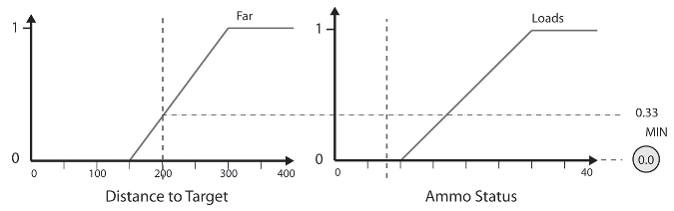
Fuzzy Inference
Let’s say the target is at a distance of 200 pixels and the amount of ammo remaining is 8 rockets.
Select rocket launcer selection rule set.
For each rule:
  Rule 1: IF Target_Far AND Ammo_Loads THEN Desirable

Slide 19
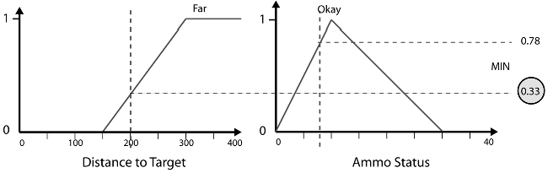
Fuzzy Inference
For each rule:
  R 1: IF Target_Far AND Ammo_Loads THEN Desirable
  R 2: IF Target_Far AND Ammo_Okay THEN Undesirable

Slide 20
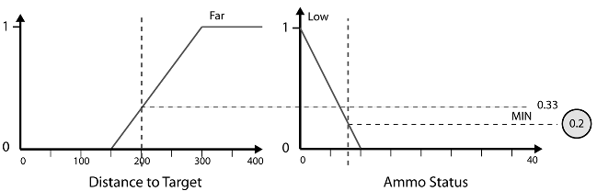
Fuzzy Inference
For each rule:
  R 1: IF Target_Far AND Ammo_Loads THEN Desirable
  R 2: IF Target_Far AND Ammo_Okay THEN Undesirable
  R 3: IF Target_Far AND Ammo_Low THEN Undesirable
  …
  R 9: IF Target_Close AND Ammo_Low THEN Undesirable

Slide 21
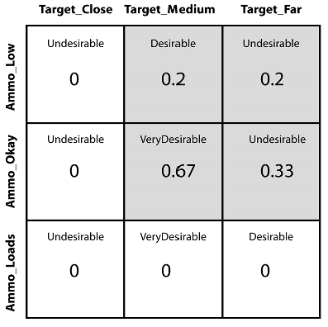
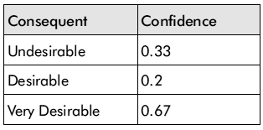
Fuzzy Associative Matrix
Summerizing

Slide 22
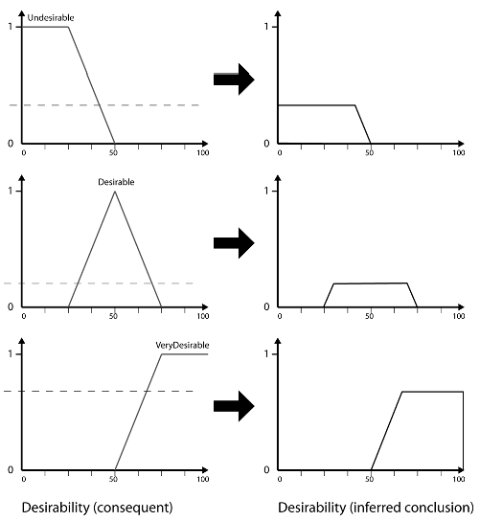
The inferred results

Slide 23
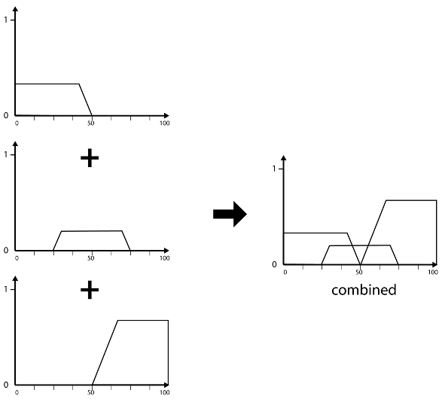
Combining the conclusions

Slide 24
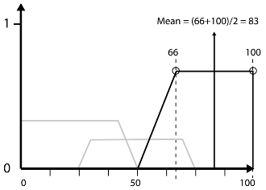
Defuzzification
Mean of Maximum (MOM)
Desirability

Slide 25
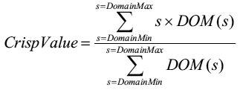
Defuzzification
Centroid
Where:
s = Value of the sample point
DOM = Degree Of Membership

Slide 26
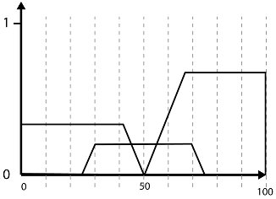
Defuzzification
Centroid
To calculate the centroid we must slice up the manifold into s sample points.

Slide 27
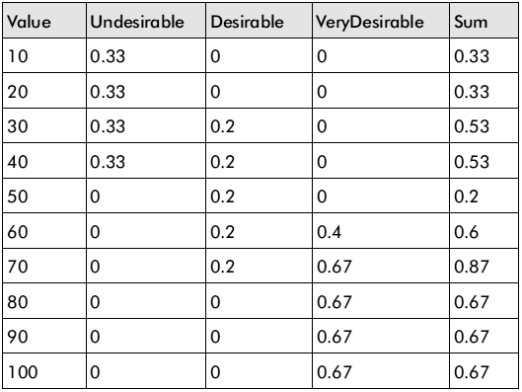
Defuzzification
and calculating the sum of the contribution of the DOM at each sample point to the total

Slide 28
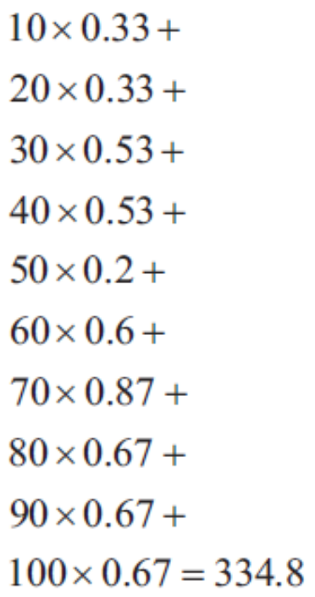
Defuzzification
and calculating the sum of the contribution of the DOM at each sample point to the total
Numerator =

Slide 29
Defuzzification
divided by the sum of the DOMs of the samples.
Denominator =
Crisp_Value (Desirability) = 334.8 / 5.4 = 62

Slide 30

Defuzzification
Average of Maxima (MaxAv)
Where:
representative value: the value where membership in that set is 1

Slide 31
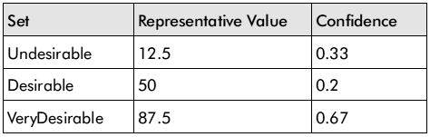
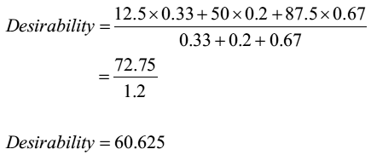
Defuzzification

Slide 32
Game
Over

